Slide 1
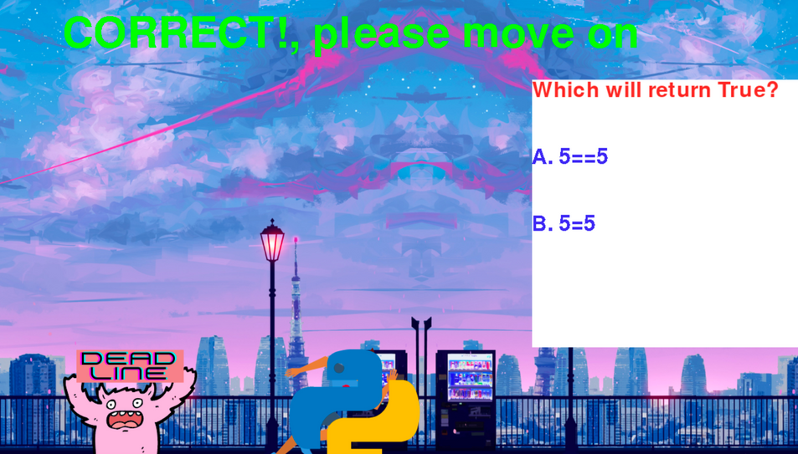
TEAM
PROGRESS
ON OUR IT PROJECT

Slide 2
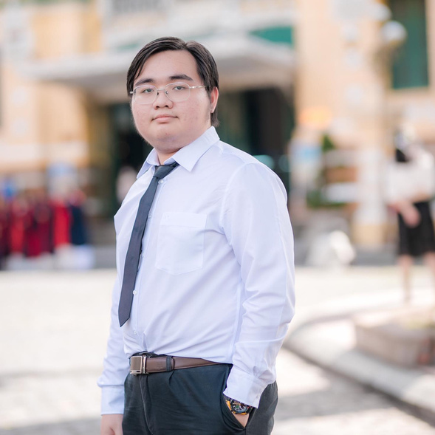
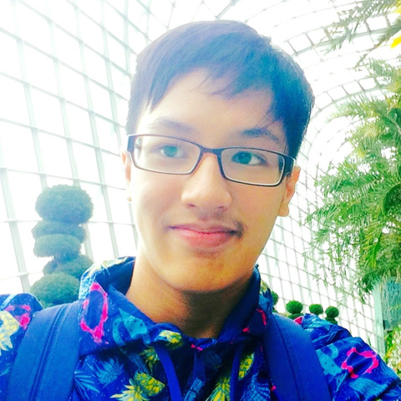
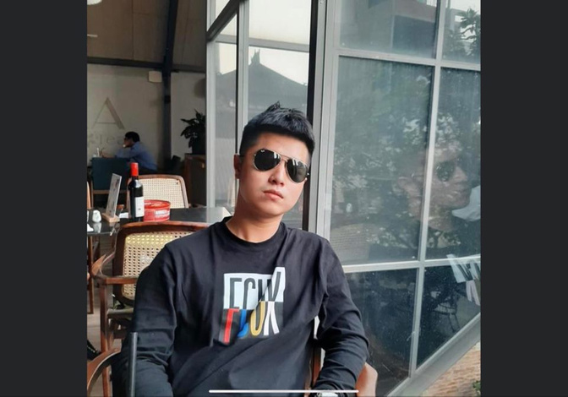

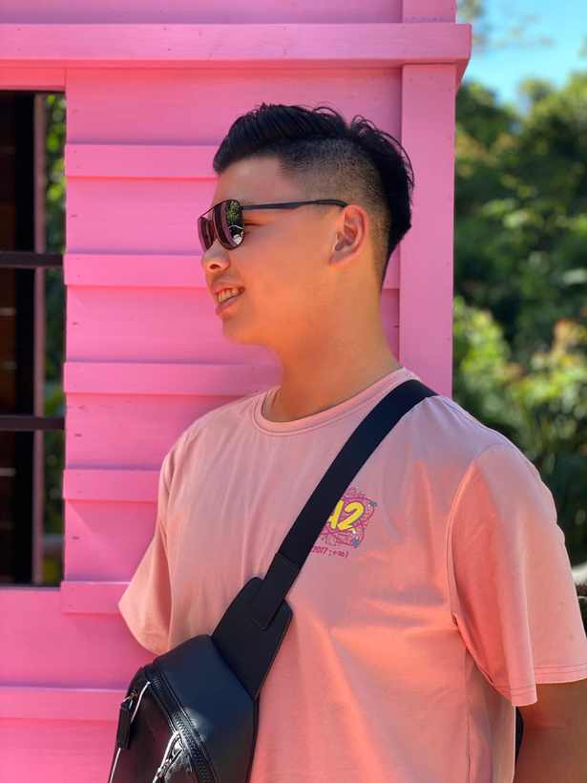
About our team
Me and the boiz
Dang Nhat
Quang Duy
Duc Anh
Minh Long
Quoc Bao
Back-end supervisor
Content
Content
Front-end supervisor
Team leader

Slide 3
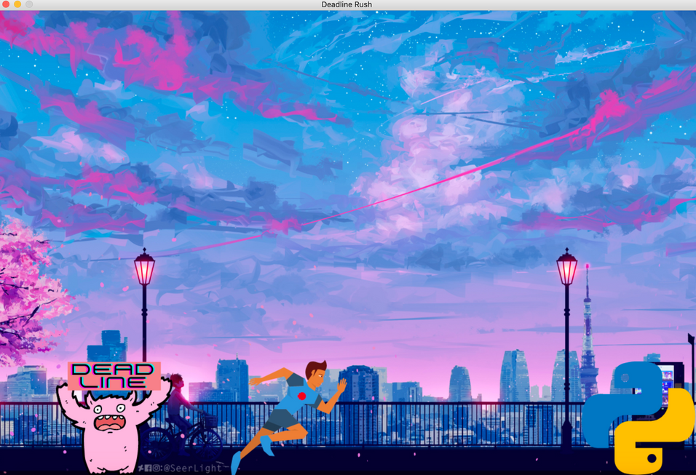
About our project
Deadline Rush
Deadline rush is an endless running game where players must correctly answer academic questions to get a pass. If not, they will be eaten by a monster called "Deadline"

Slide 4
Progess
X-mas break
29/12/2020 -3/1/2021
Learn pygame on youtube and google
Complete career plan, team name, personal information, overview, detailed description, time frame, feedback
Practice by creating tictac toe and ping pong game
Find source (image, icon)
3/1/2021
28/12/2020
Make cover pages
Make a survey about play-based learning
Devide work for report wrting
Collect other works and summarize the report
Excute the report
31/12/2020
4/1/2021
Discuss about website features
Complete game demo
Asking teammates for feedbacks
5/1/2021
Begin making website

Slide 5
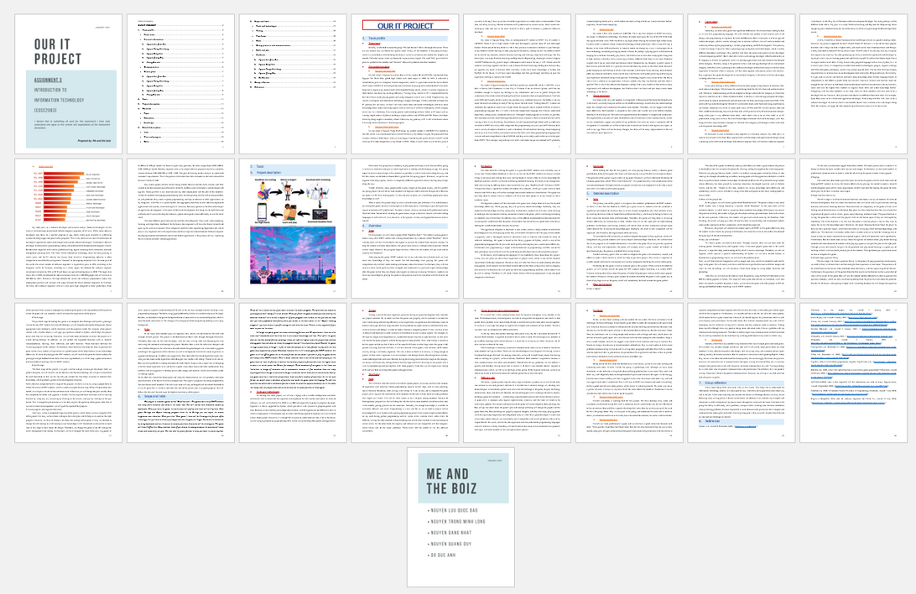
Our report
is finished with 25 pages and ready for consultation

Slide 6
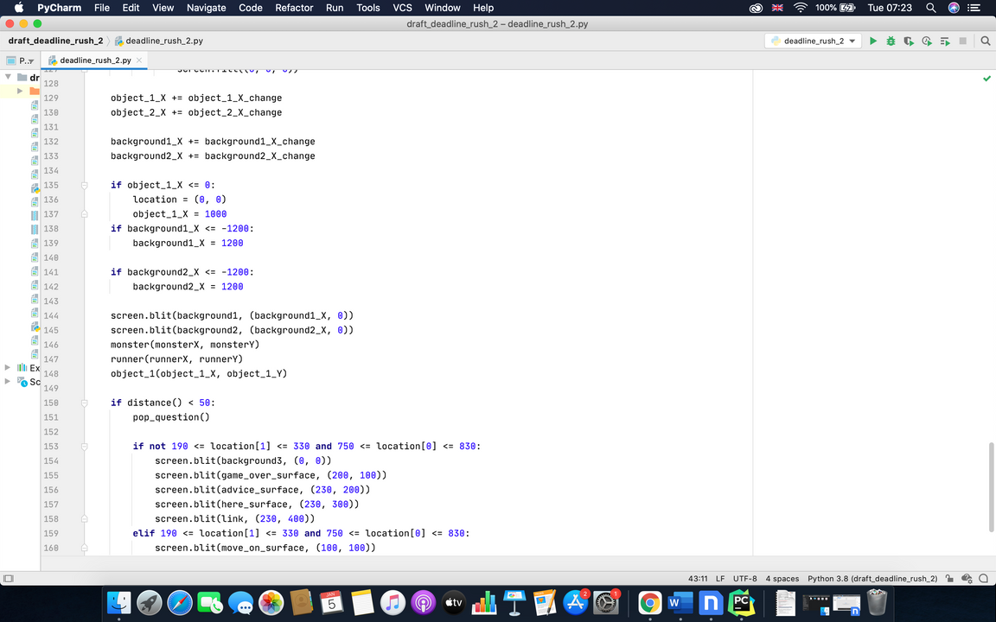
Demonstration

Slide 7
Q & A
Any questions?

Slide 8
Contact
s3877698@rmit.edu.vn
+84913981323

